Slide 1

What Is Leadership?
Leadership
The ability to influence a group toward the achievement of goals or a vision.
Management
Use of authority inherent in designated formal rank to obtain compliance from organizational members.

Slide 2
Leadership Theories
Trait (upto late 1940s)
  Theories that consider personality, social, physical, or intellectual traits. (leaders are born, not trained)
Behavior (until late 1960s)
  Theories proposing that specific behaviors differentiate leaders from non-leaders. (Leadership traits can be taught.)
Contingency (current dominant approach)
  Theories that situational factors impact leadership effectiveness.

Slide 3
Trait Theories
Nelson Mandela, Steve Jobs, Margaret Thatcher, Richard Branson – recognised as charismatic, enthusiastic, courageous leaders
Researchers are continuously searching for the trait mix that will make for an effective leader.
Very difficult to isolate the leaders’ traits...until Big 5
Extraversion (ambition & energy) appears to be an important trait for emerging (not effective) leaders
Conscientious (ability to be disciplined and keep commitments)
Recent studies say Emotional Intelligence (EI) is an important trait for effective leadership
A person can have training, great analytical mind, a compelling vision and endless supply of ideas ….but without EI ….may not make a great leader

Slide 4
Trait Theories
Limitations:
No universal traits found that predict leadership in all situations.
Traits predict behavior better in “weak” than “strong” situations.
Better predictor of the appearance of leadership than distinguishing effective and ineffective leaders.

Slide 5
Behavioural Theories
Is there some unique behaviour among leaders?
Ohio State Studies (in late 1940s)
Aim: to identify independent dimensions of leader behaviour
began with over 1000 dimensions, narrowed to two
  Initiating Structure:
  Extent to which a leader is likely to define and structure his/her role and that of employees in the search for goal attainment
  Application: assigns group members to tasks, expect definite stds of performance, emphasise meeting of deadlines
  Consideration:
  Extent to which a person will have job relationships characterised by mutual trust, respect for employee ideas, regard for their feelings, their comfort, well being, satisfaction, treats all employees as equals, is approachable

Slide 6
Behavioral Theories
University of Michigan (similar to Ohio)
Came up with two dimensions
  Production Oriented
  Emphasized on the task or technical aspect of the job – their main concern was task completion – employees were just a means to an end
  Employee Oriented
  Such leaders emphasize inter personal relations
Initiating structure is similar to production oriented while consideration is similar to employee oriented.
As a result most leadership researchers use these terms interchangeably.

Slide 7
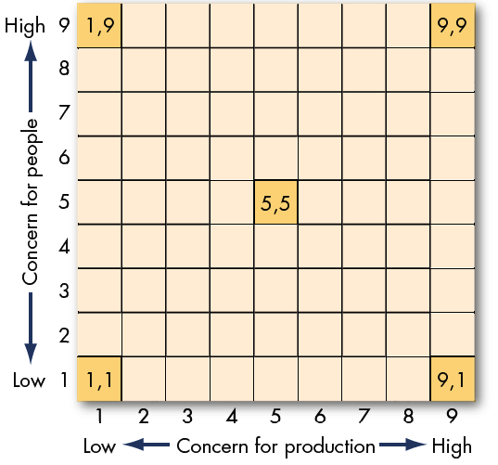
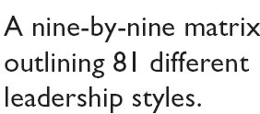
The Managerial Grid
(Blake and Mouton)
End result?
Nothing new to add to Ohio or Michigan research

Slide 8
Contingency Theories
Example: Linda Wachner of Warnaco
Fiedler’s Contingency Model
Hersey and Blanchard’s Situational Leadership
Leader Member Exchange Theory
Path Goal Theory
Leader Participation Theory

Slide 9

Contingency Theories
Fiedler’s Contingency Model
The theory proposes that effective group performance depends on a proper match between a leader’s style of interacting with subordinates and the degree to which the situation gives control and influence to the leader.
Fiedler believed that a key factor to leadership success is an individual’s leadership style.
So he begins to find out what that basic style is.
Result : Least Preferred Co-worker questionnaire

Slide 10
Contingency Theories
Least Preferred Co-Worker (LPC) Questionnaire
An instrument that seeks to measure whether a person is task-oriented or relationship-oriented.
Contains 16 contrasting adjectives (e.g. pleasant – unpleasant, supportive-hostile, etc.)
Ask person to describe the ‘one person’ they least enjoyed working with on a scale of 1 to 8
A high LPC score implies you’re ‘relationship oriented’
A low LPC score indicates ‘task oriented’.
About 16% fall in neither category
Fiedler’s assumption: An individual’s leadership style is fixed.
Thus, it is necessary to match the leader with the situation

Slide 11
Findings from Fiedler’s model
Application:
Change leader to fit the situation
Change situation to fit the leader
Fiedler’s assumption:
Leadership style is fixed

Slide 12
Paul Hersey and Ken Blanchard’s
Situational Leadership Theory
A contingency theory that focuses on followers’ readiness.
Viz. Successful leadership is achieved by selecting the right leadership style which is contingent on the level of the followers’ readiness.
question: Why focus on the follower and what is the meaning of readiness?
It is the follower who accepts or reject the leader
Readiness refers to the extent to which people have the ability and willingness to accomplish a specific task.
SLT views Leader – Follower relationships as analogous to Parent – Child relationship

Slide 13
Hersey and Blanchard’s Situational Leadership Theory
H&B identified four specific leader behaviour – from Highly Directive to Highly Laissez-faire
Unable and
Unwilling
Unable but
Willing
Able and
Unwilling
Able and
Willing
Follower readiness:
ability and willingness
Leader: decreasing need
for support and supervision
Directive
High Task and Relationship Orientations
Supportive Participative
Monitoring

Slide 14
Leadership Styles and Follower Readiness
(Hersey and Blanchard)
SLT has an intuitive appeal – since it acknowledges the importance of followers and builds on the logic that leaders can compensate for ability and motivational limitations in their followers.

Slide 15

Leader–Member Exchange Theory
Leader-Member Exchange (LMX) Theory
Because of time pressures, leaders establish a special relationship with a small group of their followers.
Leaders create in-groups and out-groups, and subordinates with in-group status will have higher performance ratings, less turnover, and greater job satisfaction.
How do leaders choose in-group members?
attitude, personality, competence
Note: Even though it is the leader who is choosing, it is the follower's characteristics that is driving this choice

Slide 16

Path-Goal Theory (Robert House)
Path-Goal Theory
The theory suggests that it is the leader’s job to assist followers in attaining their goals and to provide them the necessary direction and/or support to ensure that their goals are compatible with the overall objectives of the group or organization.

Slide 17
Path-Goal Theory (Robert House)
House identified four leadership bahaviour:
Directive leaders: lets followers know what is expected of them, schedules work to be done, gives guidance on how to ...
Supportive leaders : friendly and shows concern for the needs of followers
Participative leaders: Consults with followers and uses their suggestions before making a decision
Achievement oriented: sets challenging goals, expects followers to perform at highest level
House assumes leaders are flexible and can display any or all behaviours to match the situation

Slide 18

Leader-Participation Model
Leader-Participation Model (Vroom and Yetton)
Related to leadership behaviour and participation in decision making.
Argues that leader behaviour must adjust according to the task structure
A leadership theory that provides a set of rules to determine the form and amount of participative decision making in different situations.

Slide 19
Contingency Variables in the Revised
Leader-Participation Model
Lone decision of leader
Importance of the decision
Importance of obtaining follower commitment to the decision
Whether the leader has sufficient information to make a good decision
How well structured the problem is
Whether an autocratic decision would receive follower commitment
Whether followers “buy into” the organization’s goals
Whether there is likely to be conflict among followers over solution alternatives
Whether followers have the necessary information to make a good decision
Time constraints on the leader that may limit follower involvement
Whether costs to bring geographically dispersed members together is justified
Importance to the leader of minimizing the time it takes to make the decision
Importance of using participation as a tool for developing follower decision skills
Consensus decision
Stress, intelligence and experience are important situational variables. The LP Model does not include these.

